Slide 1

Polymers
Louisiana Tech University
College of Engineering and Science
BIEN 235
Dr. Teresa Murray

Slide 2
Louisiana Tech University
College of Engineering and Science
Polymers
Largest class of biomaterials
poly = many
mer = unit, single unit called a “monomer”
polymer = many units
Plastic, rubber, proteins and other molecule chains (> 1000 units) are all polymers.
Relatively low melting point & low density v. metals
Mainly non-metal atoms
Notes:
Polymers are the largest class of biomaterials. They are long chains of molecules that are covalently bonded. The name describes this; it has two terms, poly (meaning many) and mer (meaning a single unit, in this case, a single molecule). Polymers can be made of manmade or natural mers, or molecules). The mers in a polymer can be made of the same mer or molecule or they can have more than one type, as we will see in slides that follow. Reflecting this diversity, polymers are commonly called plastic, rubber, proteins, peptides, oligonucleotide, and other names that elude to the type of mers in the polymer. When used in medical devices, polymers typically have thousands to hundreds of thousands of mers.
Polymers can be classified as natural or manmade.

Slide 3
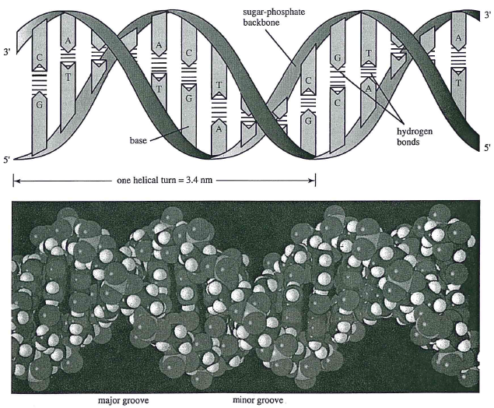
Louisiana Tech University
College of Engineering and Science
Fig. 9.7, Temenoff and Mikos (2008) Biomaterials text
Notes:
DNA, RNA, and proteins are natural polymers. Genetic engineers have been manipulating DNA and RNA for decades to change one or more amino acids in a protein. (Amino acids are the mers that make up proteins.) Being able to change one or more amino acids in a protein by genetic engineering of DNA or RNA has helped scientists discover the function of particular parts of proteins in the body. DNA and RNA can also be used as the building blocks for designer molecules called aptamers. Aptamers have been used as small, manmade molecules that specifically bind to other molecules in the body, similar to antibodies. The ability of DNA to form double strands has been employed to form unnatural materials, such as molecular screens made of a grid, or mesh, of DNA molecules.

Slide 4
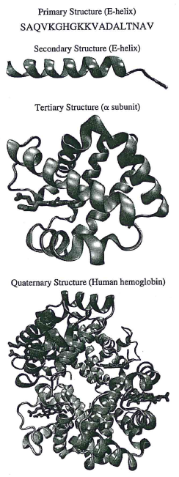
4 levels of protein structure
Louisiana Tech University
College of Engineering and Science
Fig. 8.7, Temenoff and Mikos (2008) Biomaterials text
Notes:
Proteins are a large, diverse class of natural polymers. They make up much of the plant and animal world. Proteins are made from the sequential addition of covalently bonded amino acids which results in a linear chain. This is known as the primary structure. Each letter inn the example is an abbreviation for a type of amino acid. As you can see, there are many types of amino acids in proteins. Amino acids vary in shape and charge. Based on patterns in the shape and electrical charges in the amino acids, parts of the chain will naturally fold or twist into shapes. These shapes can form short helixes and sheets. This natural folding is know as secondary structure. A protein will continue to fold into a more complex, tertiary structure because of natural attraction and repulsion of amino acids in the secondary structure and with the help of chaperone proteins inside the cell. Some proteins are made of two or more proteins. In this case each of the proteins is known as a subunit. When this occurs, it is known as quaternary structure.

Slide 5
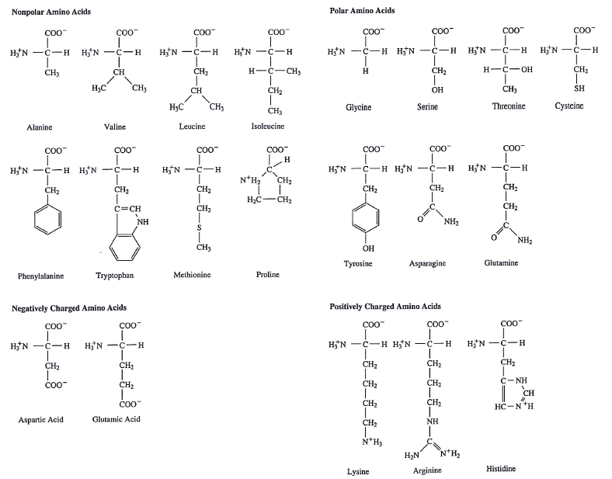
Note: This is for your reference only (you do not need to memorize it)
Fig. 8.4, Temenoff and Mikos (2008) Biomaterials text
Notes:
These are stick diagrams that represent the atoms in each amino acid (AA). Every amino acid has the same H2N-C-COO-H structure. They differ in the atoms that make up the side group. Side groups range from 1 atom on glycine (upper row) to over 20 atoms in Tryptophan. The amino acids are grouped according to the type of electrical charge (or charges), or lack of charge of the side group. A nonpolar AA has all or primarily carbon and hydrogen groups (CH, CH2 and CH3) in the side group; these do not have an electrical charge. Polar AA’s have a additional atoms in the side group, such as OH, H, SH, and NH2 that make the molecule partially charged. Negatively charged AA’s have a full negative charge in the side group (i.e., COO-). Likewise, a positively charged AA has a full positive charge from N+ in the side group.

Slide 6
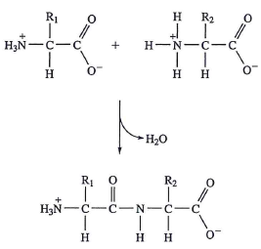
Peptide synthesis is by a condensation reaction
Reaction produces water
As amino acids are added, the first amino acid still has a positive charge and the last one added has a negative charge.
Fig. 8.5, Temenoff and Mikos (2008) Biomaterials text
Notes:
The start of the protein chain has the is called the N-terminal (N for nitrogen in the unbound H3N+ group that remains in the completed protein). The end of the protein has the unbound COO- group and it is know as the C-terminal.

Slide 7
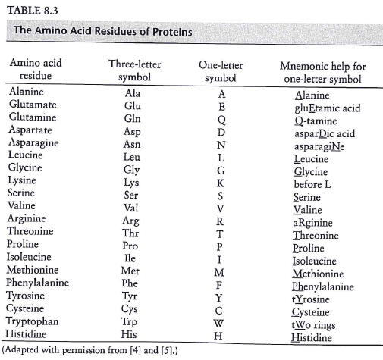
You do not need to memorize this table.
Table 8.3, Temenoff and Mikos (2008) Biomaterials text
Notes:
This table shows the two systems of abbreviations for amino acids. When the three letter system is used, the AA abbreviations are separated by hyphens. For the single letter abbreviations, the AA’s are written as a series of single letters. In both cases, the AA’s appear in the same order as they have in the protein from the N-terminal to the C-terminal end.

Slide 8
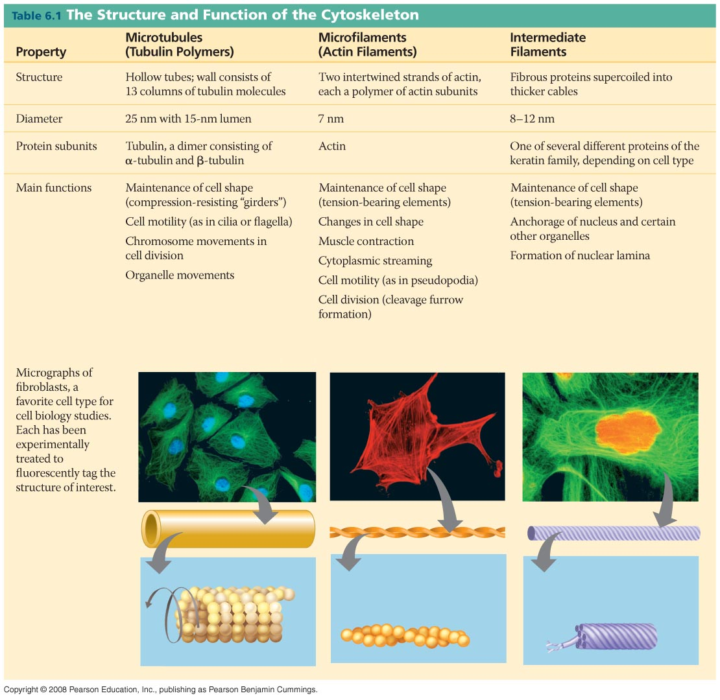
Cytoskeleton components
Louisiana Tech University
College of Engineering and Science
This is one of many types/functions of proteins.
Downloaded (2013) from http://learn.genetics.utah.edu/content/begin/cells/scale/
Notes:
Antibody labeling with fluorescent dyes and colored stains are used to visualize tiny proteins in cells. Some proteins form long molecular fibers that form the structural support for cells. Some of these fibers also serve as “highways” for moving small cargo, such as vesicles containing freshly made receptors that will be inserted into the plasma membrane of the cell.

Slide 9
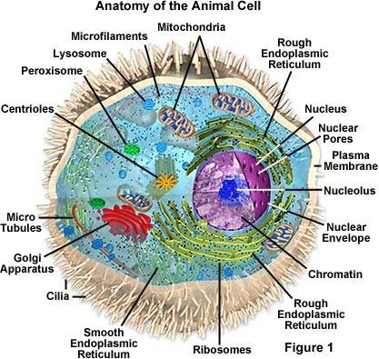
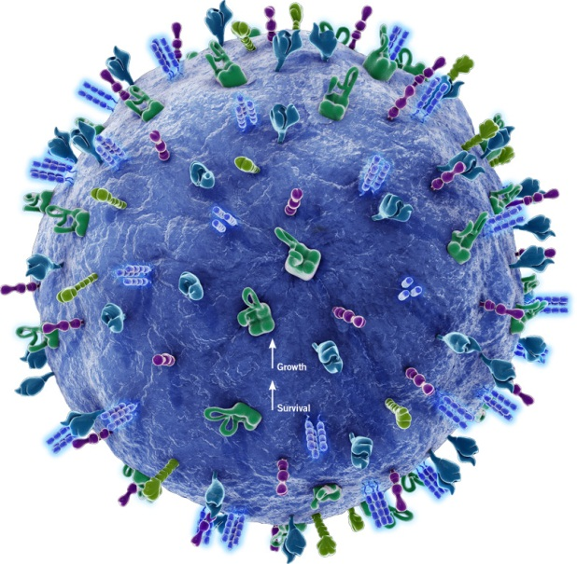
Why consider cells in biomaterials?
Louisiana Tech University
College of Engineering and Science
http://www.biooncology.com/therapeutic-targets/cd22
http://micro.magnet.fsu.edu/cells/animalcell.html
No need to memorize parts of cell
Notes:
If there is time, have students work in small groups to discuss reasons why cells are important with respect to biomaterials.
1. Receptors (in the cell plasma membrane) react to materials in or on the body.
2. Cells can change functions based on the mechanical properties of materials. You will learn more about this in Project 1: Orthopedic Implant Redesign

Slide 10
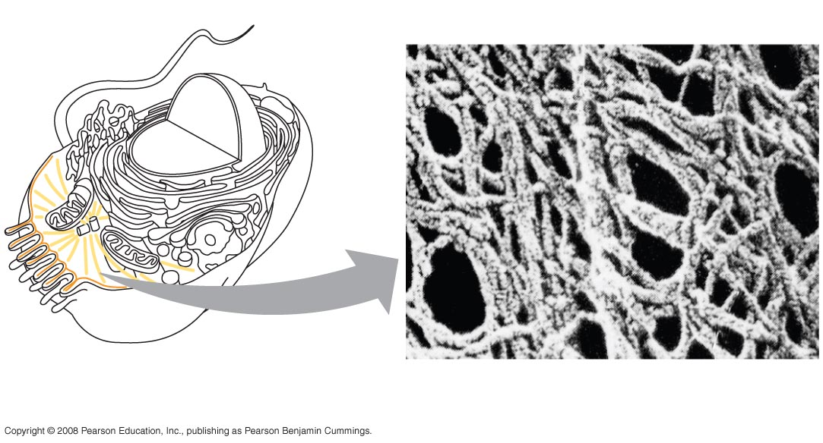
Proteins inside & outside cells
Louisiana Tech University
College of Engineering and Science
Inside cell
Microtubule
Microfilament
Notes:
This slide shows a couple of types of proteins found inside cells.
Left: Cartoon cut-away view of a cell with major organelles.
Right: Electron microscope image inside a cell that shows a microtubule and microfilaments. Each are composed of protein subunits. This meshwork of proteins provides internal support that gives cells their shape. Some filaments are used my molecular motors to move vesicles from one area of the cell to another.

Slide 11
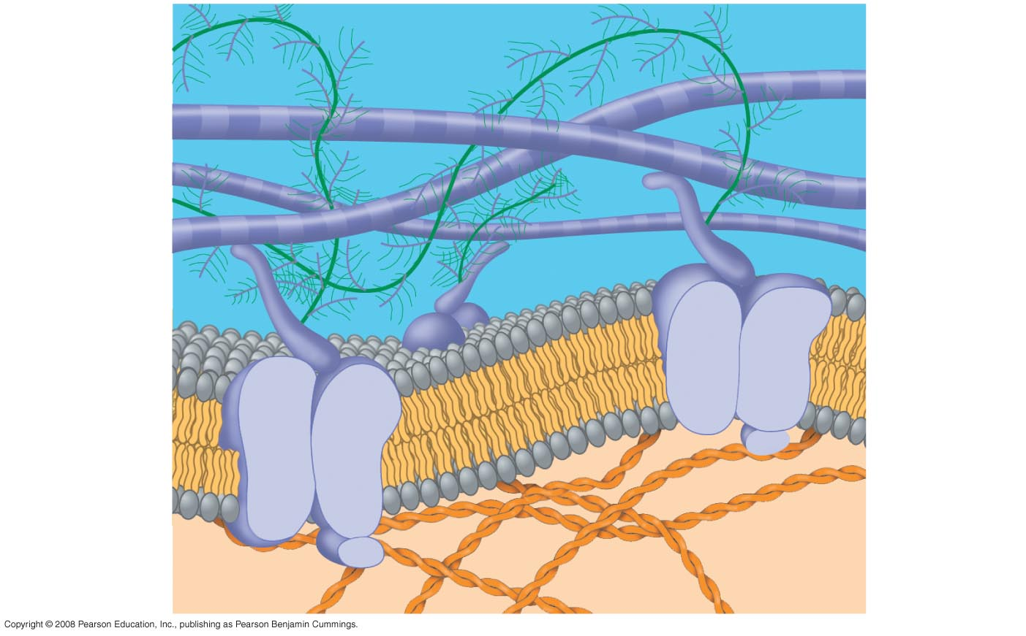
Louisiana Tech University
College of Engineering and Science
Outside cell
Collagen
(proteins)
EXTRACELLULAR FLUID
outside of cell
Proteoglycan complex
Fibronectin
(protein)
Integrins
(proteins)
Plasma membrane
of a cell
Micro-filaments
CYTOPLASM
of a cell
Notes:
This diagram shows the phospholipid bilayer of the cell (gray and yellow) connected to structural proteins inside the cell (orange). The extracellular fluid (a.k.a., interstitial fluid) is colored blue. The extracellular matrix (ECM) is composed of proteins such as collagen and fibronectin and proteoglycan complexes (made of proteins and polysaccharides). Cells have integrins (shown) and other types of molecules that bind to the ECM. This ability is especially important for organs, like the intestines and the bladder, that need a strong yet pliable layer of cells to enclose spaces and keep fluid contained in an area. In these applications, the ECM is often called the basal lamina (see illustration on “Collagen” slide).

Slide 12
Louisiana Tech University
College of Engineering and Science
Extracellular matrix (ECM)
Insoluble networks comprised of several macromolecular components (natural polymers)
Several types have roles in organ development
Studies of synthesized ECM analogs have been evaluated as implants.
Figure from Chapter 2.8, Ratner et al., 2004

Slide 13
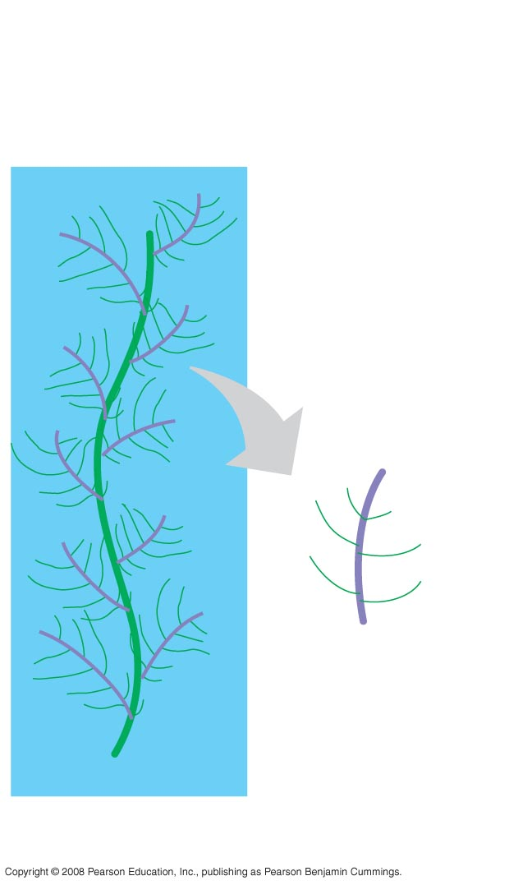

Proteoglycans in ECM
Louisiana Tech University
College of Engineering and Science
Carbohydrates
(chains of saccharides)
Protein
Core protein
All of these are polymers
Glycosaminoglycan
Proteoglycan complex
Notes:
Proteoglycans have a protein core with glycosaminoglycan branches. Glycosaminoglycan branches (a.k.a. GAGs) have a protein core and carbohydrate (chain of saccharides) branches.

Slide 14
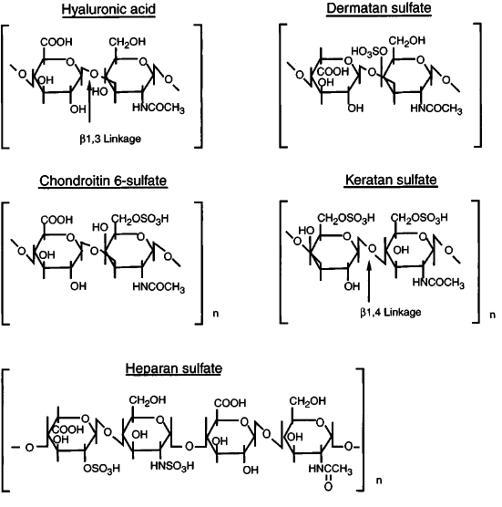
Louisiana Tech University
College of Engineering and Science
Glycosaminoglycan Have repeating disaccharide units (some shown to left) on protein core.
These molecules are polar.
What will that do in the body?
Hint: Look at chondroitin sulfate, the most prevalent GAG in body.
No need to memorize structures
Chapter 2.8, Ratner et al., 2004
Notes:
This is a thinking question for outside of class.

Slide 15
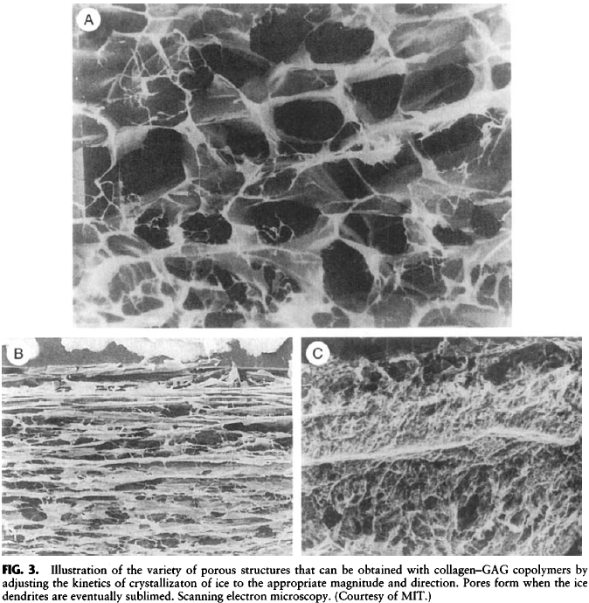
Louisiana Tech University
College of Engineering and Science
Pore structures:
collagen-GAG copolymer
Chapter 2.8, Ratner et al., 2004
Notes:
Cells have diameters on the order of a few microns. Thus, artificial ECM should have spaces this large to support cells. Pore sizes may be varied for other applications, such as absorbing fluid or filtering it.

Slide 16
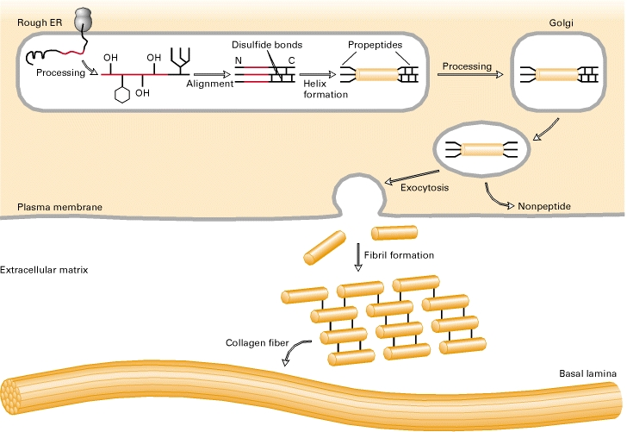
Collagen
Louisiana Tech University
College of Engineering and Science
Cell
http://www.ncbi.nlm.nih.gov/books/NBK21582/
Notes:
Collagen fibrils are formed inside cells, such as fibroblasts. The fibrils are exported into the extracellular fluid by a process called exocytosis. Once outside the cell, they self-assemble into fibers.

Slide 17
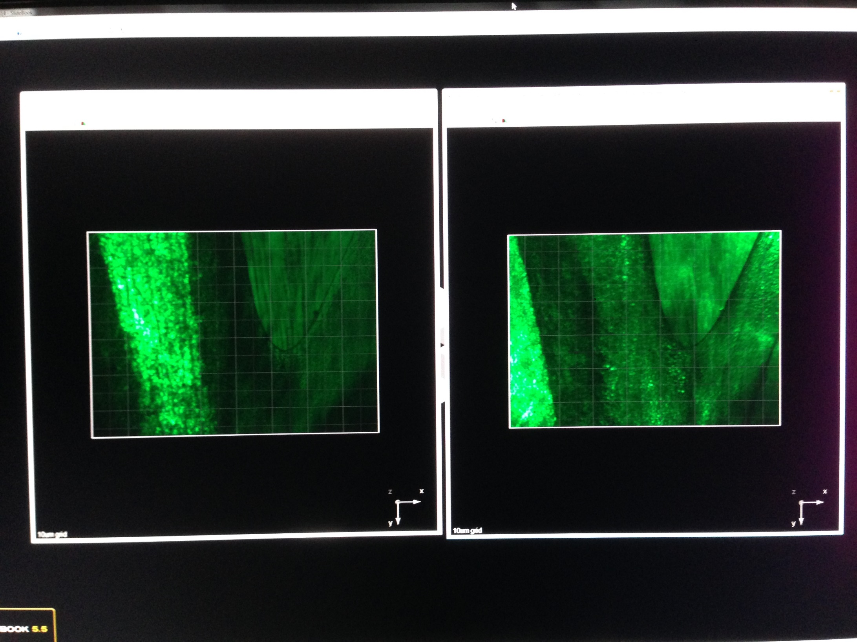
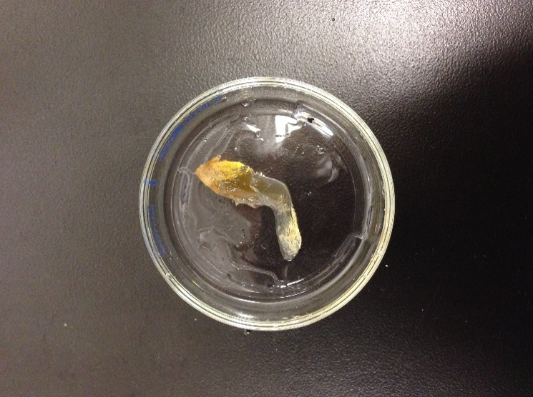
Multiphoton microscopy
Louisiana Tech University
College of Engineering and Science
Optically cleared mouse leg
Ordered biomolecules in bone and muscle
Teresa Murray, PhD, 2013, unpublished
Notes:
A multiphoton imaging technique called second harmonic generation (SHG) was used to capture this image INSIDE the leg of a mouse. SHG produces images from highly ordered structures such as collagen and other proteins in muscle and collagen in bone. Can you see that the organization of proteins is different in muscle versus bone?

Slide 18
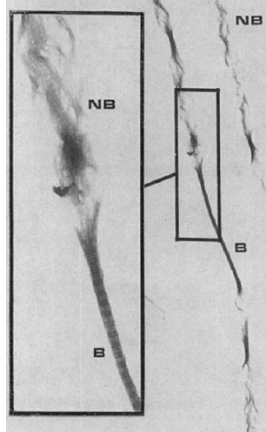
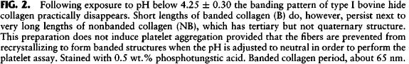
Louisiana Tech University
College of Engineering and Science
Collagen degradation
Collagen with banded structure (B):
What level of protein structure is in the banded part of the collagen?
Collagen partly degraded by low pH (NB):
What level of structure is in the NB part?
Figure 2 - cropped, Chapter 2.8, Ratner et al., 2004
Notes:
Break into small groups to discuss these two questions. You may want to review the earlier slide on protein structure and the one on collagen structure.
Answers: B has quaternary structure (several parallel groups of long chains of protein subunits). NB has tertiary structure (long chains of protein subunits - fibrils).

Slide 19
Louisiana Tech University
College of Engineering and Science
Elastin
Three-dimensional cross-linked network of proteins
Highly amorphous
Rubbery elasticity
One of least soluble proteins in body
Extraction: dissolve/degrade adjacent substances
Mechanical measurements show average of 71-84 amino acid units between cross-links
Insoluble elastin preparations can be degraded by elastase
Soluble preparations not yet been applied extensively
Figure from Chapter 2.8, Ratner et al., 2004

Slide 20
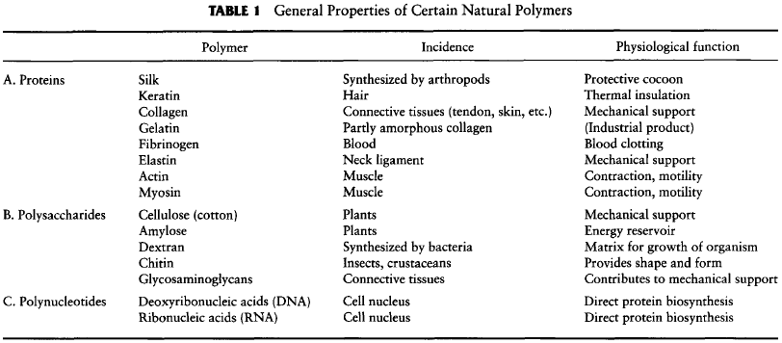
Louisiana Tech University
College of Engineering and Science
Figure from Chapter 2.8, Ratner et al., 2004

Slide 21
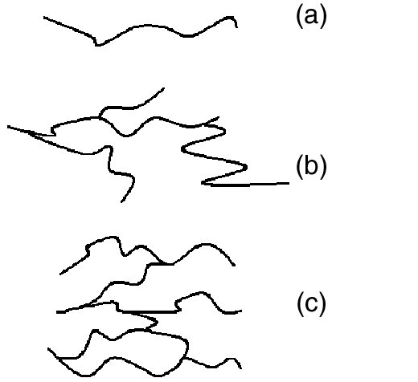
Louisiana Tech University
College of Engineering and Science
Manmade polymer arrangements
© 2014 C. M. Agrawal, J. L. Ong, M. R. Appleford and G. Mani
Figure 6.3
Notes:
These cartoons represent the many forms of manmade polymers.

Slide 22

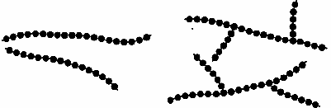
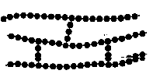
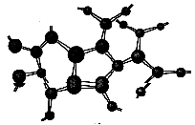
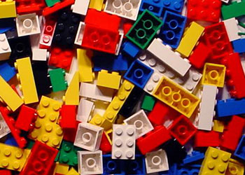
Thermoplastics: Plastic, mainly due to flexibility of -C-C-
Elastomers (rubbers): Elastic. Low density of cross-links act as micro-springs
Thermosets: Hard & Brittle. High density of cross-links confer rigidity.
Chen and Thouas, Chap 4

Slide 23
Louisiana Tech University
College of Engineering and Science
Advantages of manmade polymers
Density close to natural tissues (~1 g/cm³)
Similarities to biopolymers
long chains of repeating units
relative flexibility (versus ceramic & metal)
Disadvantages
Low modulus and viscoelastic behavior
poor load-bearing properties
Degrade
Processing impurities can leach

Slide 24
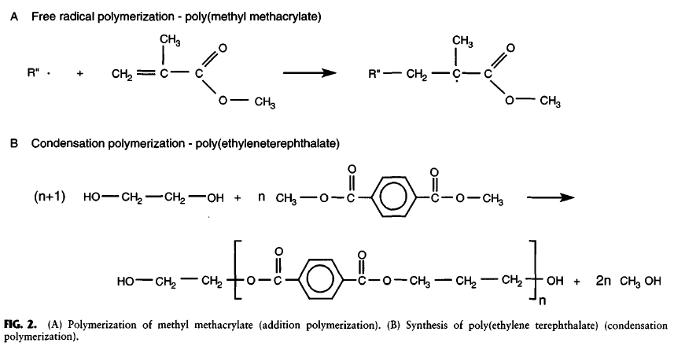
Louisiana Tech University
College of Engineering and Science
Addition polymerization
Addition, or free radical polymerization, occurs by free radical, anion, cation, or stereospecific catalyst
Figures from Chapter 2.2, Ratner et al., 2004
Notes:
There are two types of polymerization methods. One is addition polymerization. It uses a reactive chemical to form chains of molecules from monomers. One example is poly(methyl methacrylate), also called PMMA. You will make PMMA in the fume hood in next week’s lab. Do not make this in a poorly ventilated room because it smells and long repeated exposure can be unhealthy for you.

Slide 25
Louisiana Tech University
College of Engineering and Science
Condensation polymerization
Water or other small molecule released
Figures from Chapter 2.2, Ratner et al., 2004
Notes:
The other means of forming polymers is condensation polymerization. As its name implies, a condensate such as water or other chemical is released for each mer that is added to the chain. The example above is poly(ethyleneterephthalate), also called PET. Many soda bottles are made from PET.

Slide 26
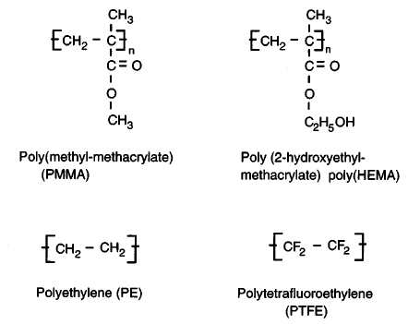
Louisiana Tech University
College of Engineering and Science
Common monomers in biomaterial polymers
Adapted from Fig. 5, Chapter 2.2, Ratner et al., 2004
Notes:
PMMA is used in bone cement in some orthopedic implant systems, poly(HEMA) is used in soft contact lenses, polyethylene is used in many different types of implants, and PTFE is used to make some vascular grafts.

Slide 27
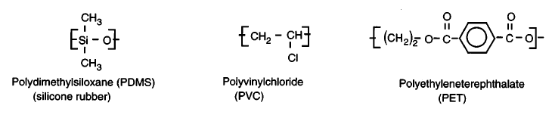
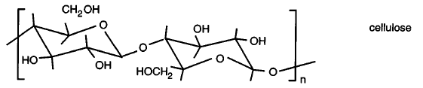
Louisiana Tech University
College of Engineering and Science
Common monomers in biomaterial polymers
Adapted from Fig. 5, Chapter 2.2, Ratner et al., 2004
Notes:
These are some other common monomers that are in polymers used for biomedical and other applications.

Slide 28
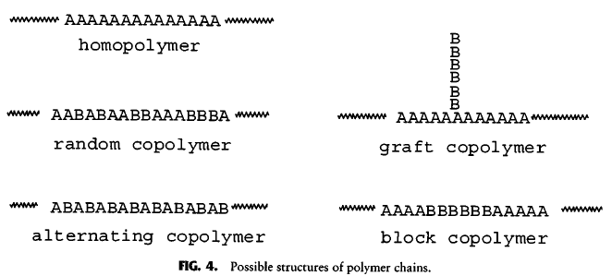
Louisiana Tech University
College of Engineering and Science
Basic polymer structures
Linear and graft polymers
Homopolymers, copolymers and block copolymers
Figures from Chapter 2.2, Ratner et al., 2004
Notes:
Five basic types of polymer structures are show in these illustrations. In addition to the type of mers used, each type of arrangement confers different mechanical properties to the polymer. Other mechanical properties can be affected by the number and spacing of blocks and grafts.

Slide 29
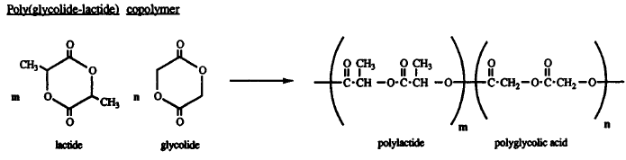
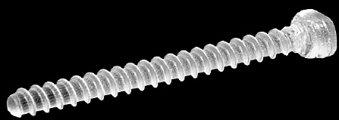
Louisiana Tech University
College of Engineering and Science
PGA – PLA Copolymer
Absorbable suture, Vicryl®: 90% PGA and 10% PLA
Drug delivery and scaffolds: 50% PGA and 50% PLA
Also some screws, as shown
Agrawal et al., 2014 textbook (pages 150 - 151)
Chemical diagram adapted from Fig. 6, Chapter 2.2, Ratner et al., 2004
Notes:
Example of a common co-polymer for biomedical applications. See information on slide.

Slide 30
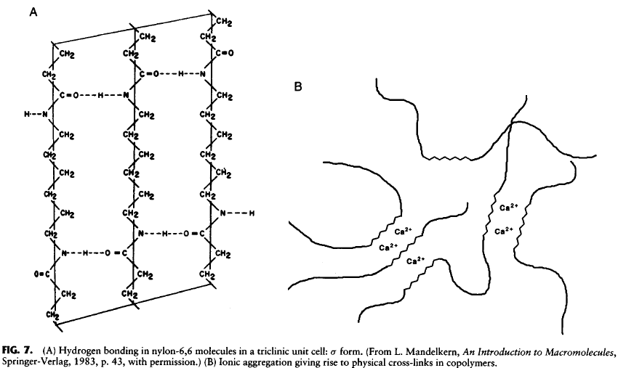
Louisiana Tech University
College of Engineering and Science
Hydrogen bonding (A) and counter ions (B) hold some chains in place
Figures from Chapter 2.2, Ratner et al., 2004
Notes:
Relatively weak bonds (in comparison to covalent bonds) hold polymer chains together. The polymers are strong because of the relatively large number of these weak bonds. Think about how a gecko stays on a window with thousands of tiny sticky pads on its feet. Even though each sticky pad is miniscule in comparison to the size of the reptile, the huge number of pads easily keeps to gecko from falling off of a window or wall.

Slide 31
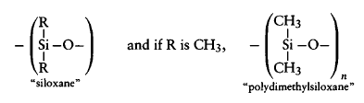
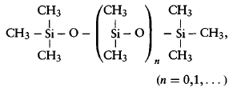
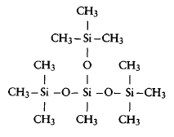
Louisiana Tech University
College of Engineering and Science
Silicones
Crosslinking chains creates 3D network, changes properties (e.g., E and thermal stability).
One of many forms
Figures from Chapter 2.3, Ratner et al., 2004
Notes:
Some polymers have covalent crosslinks. Silicones, such as polydimethylsiloxane (PDMS) are vey tough (rubbery) because it has a large number of crosslinks. Crosslinking chains creates 3D network, changes properties, such as E and thermal stability. Adding fillers increases hardness and improves strength.

Slide 32
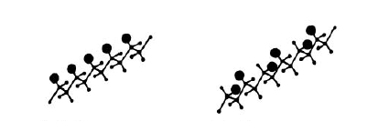
Louisiana Tech University
College of Engineering and Science
Tacticity
Orientation of substituent groups
random orientation
isotactic
syndiotactic
atactic
Note: Fig 8.10 in Chen & Thouas has these reversed!
Figures from Chapter 2.2, Ratner et al., 2004
Notes:
The orientation of AA side chains affects the strength and degree of transparency of the polymer. Isotactic arrangements are when side groups align to one side of the amino acid backbone. In syndiotactic arrangements, side groups align in an alternating pattern. When side groups are oriented in a regular pattern, like these examples, the chains can fold more readily to form small, crystalline regions in the polymer. Highly crystalline polymers tend to be stronger and are translucent or opaque. When side groups are randomly oriented, the polymer chains do not fold as well and the material is more amorphous and less crystalline. This results in a weaker tensile strength and a more translucent, or even clear material. This distinction is important when considering materials for contact lenses and implantable lenses for replacing natural lenses after cataract surgery.

Slide 33
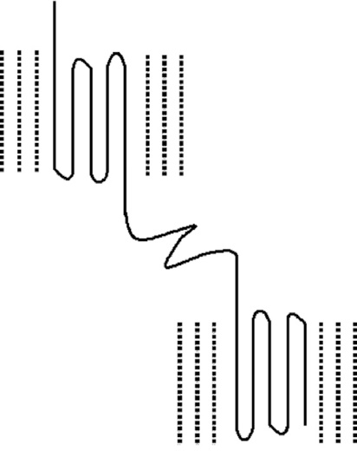
Louisiana Tech University
College of Engineering and Science
Crystalline regions
Most polymers: Mix of amorphous matrix & crystalline islands
Figure 6.6
© 2014 C. M. Agrawal, J. L. Ong, M. R. Appleford and G. Mani
Notes:
Most polymers have some crystalline and some amorphous regions. The relative proportions of crystalline and amorphous regions affects the mechanical, chemical and optical properties of polymers.

Slide 34
Louisiana Tech University
College of Engineering and Science
Crystalline regions
Crystalline islands/regions
Regular ordered structure
Secondary forces (bonds between chains) stronger than thermal energy’s disordering effect
Unbranched, isotactic or syndiotactic polymers have high degree of crystallinity
Amorphous
No ordered structure
Some have side groups that hinder crystal structure
Notes:
See the information on the slide.

Slide 35
Louisiana Tech University
College of Engineering and Science
Crystalline regions
High crystalline content (regular ordered structure)
Optical opacity (or translucence)
Higher density
Increased fatigue strength
Increased stiffness
Lowered toughness
More brittle
Higher melting temperatures
Examples:
PE
PTFE
PET
Notes:
PE, polyethylene
PTFE, poly(tetrafluoroethylene)
PET, poly(ethyleneterephthalate)

Slide 36
Louisiana Tech University
College of Engineering and Science
Amorphous polymers
Low crystalline content (highly amorphous)
Often optically transparent
Poor chemical resistance
Sensitive to creep (stretching)
Lower melting temperatures
Examples:
Acrylic
Polycarbonate
Like “spaghetti”
Notes:
In amorphous polymers, the chains can slide past each other more readily because there are fewer smaller side groups and/or less crystalline regions to hinder sliding.

Slide 37
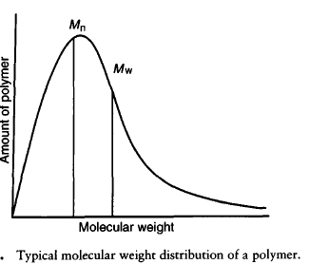
Louisiana Tech University
College of Engineering and Science
Molecular weight (MW) distribution
* In any one sample:
monomers
dimers
oligomers
chains > 10⁶ long
*
Figures from Chapter 2.2, Ratner et al., 2004
Notes:
In any polymer, there are a range of chain lengths. Longer length chains enable more chain entanglements and have more places for hydrogen and Van der Waals attractions. These help to hold the polymer in shape and give it strength. Thus, it is important to know the distribution of chain lengths in a polymer. This plot shows the distribution of polymer lengths as the amount of polymer (y-axis) versus the molecular weight (MW) of each polymer chain. The MW of the chain is highly influenced by its length and it is also influenced by the size of its side chain(s).

Slide 38
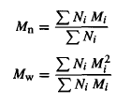
Louisiana Tech University
College of Engineering and Science
Two kinds of MW averages
Number average molecular weight, M_{n}
more sensitive to short chains
Weight average molecular weight, M_{w}
influenced more by long chains
The polydispersity index, M_{w}/M_{n}
typical range: 1.5 - 50
Figures from Chapter 2.2, Ratner et al., 2004
Notes:
The number average molecular weight, Mn and the weight average molecular weight, Mw, are calculated as shown. Each metric is skewed, as shown in the slide. To overcome these limitations, a ratio of the two measurements is used. This ratio is called the polydispersity index and it is a unitless number. A polymer with mostly the same sized chains would have a very low ratio and a polymer with a wide variety of chain sizes would have a higher index number.

Slide 39
Louisiana Tech University
College of Engineering and Science
Molecular Weight and Numbers
Most biomaterial polymers: M_{n} of 25,000 to 100,000
M_{w} of 50,000 to 300,000
Higher molecular weight increases physical properties
Ultrahigh molecular weight polyethylene (UHMWPE)
M_{w} of ~<10⁶
High melting temperature & high viscosity makes molding parts difficult
Notes:
UHMWPE is frequently used as a bearing surface in orthopedic implants, such as artificial hips and knees. This material has a high level of chain entanglement and h-bonding and Van der Waals attractions that make it a very durable polymer.

Slide 40
Slowly pull on both ends of a transfer pipette to stretch it and then pull it apart quickly. Why do polymers stretch? Why does increasing the rate of this stretch increase the chance that the material will break into two pieces?
Louisiana Tech University
College of Engineering and Science
Image source: http://www.usvaporshop.com/assets/images/3mlpipette.jpg
Notes:
(Hand out transfer pipettes to all students at the beginning of class.) Slowly pull on each end of the transfer pipette. Why do polymers stretch? Next, pull more quickly on the pipette. Keep pulling more rapidly until it breaks. Why do the pipettes tend to break when pulled rapidly versus being pulled slowly? (Students break into small groups for a 2-3 minutes to discuss these questions.)

Slide 41
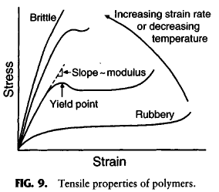
Louisiana Tech University
College of Engineering and Science
Tensile properties
Figures from Chapter 2.2, Ratner et al., 2004
Notes:
The exercise of pulling on transfer pipettes using different rates of stretching, also referred to as the strain rate, showed that plastic can stretch but that it has a tendency to break when pulled quickly. This is because a number of things are happening to the polymer chains then it is pulled. When strain is applied slowly, the bonds holding the chains together can break a little at a time, like opening a zipper or removing a Velcro strip by gently peeling back the strip a little at a time. The chains slowly straighten and the polymer part becomes longer and thinner.
If you don’t want to break your pipette as easily when you stretch it, you could heat it. Conversely, if you want it to break more easily, put it in a refrigerator for several minutes before you pull it.
This set of plots illustrates the effect of strain rate and temperature on a generic polymer. As you can see from the plot for a relatively warm polymer pulled at a slow rate, the polymer has almost no elastic region and it would be difficult to calculate an elastic modulus. (For those of you who have not yet taken the prerequisite materials course, please read about the stress-strain behavior and the elastic modulus in the textbook.) Polymers have different properties depending on their temperatures. For each polymer, there is a glass transition temperature when the polymer becomes brittle. Polymers also have a melting temperature. Why might it be important to know these temperatures when choosing polymers for a biomedical device? (Pick a student to answer the question.)

Slide 42
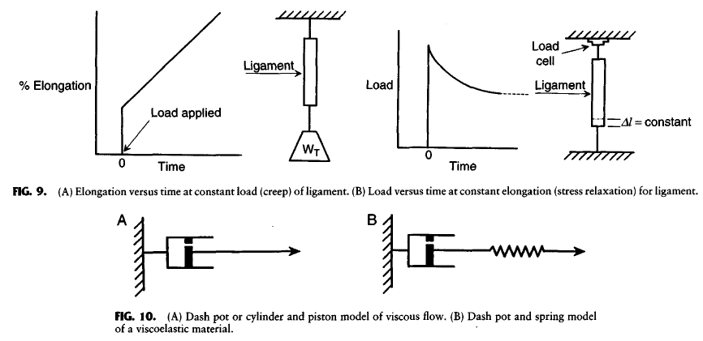
Louisiana Tech University
College of Engineering and Science
Describing the property of viscoelasticity
Figures from text: Ratner et al., 2004
Notes:
The stretching behavior of polymers can be seen in two different types of measurements. In the first type, illustrated in the upper left of this graphic, a weight is attached to a polymer sample. Immediately, the polymer will extend to some longer length. The weight is left in place and over time, the polymer stretches even further. This is one way to show the property of polymers called viscoelasticity. The immediate extension of the polymer is similar to a spring. The polymer chains can somewhat straighten out by pulling on regions that do not have many electrostatic attractions or crosslinks. If the tensile stress is immediately removed, the polymer will regain its original length. This is just like a spring. (Recall that tensile stress if the pulling force (newtons) across the cross sectional area (m^2) of a material.) If the stress is not immediately removed, then the polymer will slowly and permanently deform because the chains will rearrange. This can be represented, or “modeled” as a piston, which is also called a dash pot. Dash pots/pistons are composed of a cylinder, a piston with a small hole and a seal. When the piston is pulled, a vacuum is generated which creates a resistive force that slows the movement of the piston. The small hole in the piston allows air to slowly enter the cylinder and remove the vacuum which reduces the force of the vacuum. This is represented by the slow elongation over time in the plot in the upper left (the sloped part of the plot). In reality, the elongation is over time is not usually linear. But this plot still serves as a useful illustration of the property of viscoelasticity. The lengthening of the polymer sample refers to a viscoelastic behavior called creep.
A way to observe another viscoelastic behavior, called stress relaxation, is to attach each end of a polymer sample to a movable frame. The frame has with a load cell that measures the tensile force applied to the sample. The frame is pulled apart so that there is a relatively large tensile force on the sample. Then, the frame is left at that position for several weeks. Over time, the force on the load cell steadily decreases. Why? (Have a 2-3 min discussion in small groups or ask a student in the class to answer the question. Hint: think about the transfer pipette exercise.)

Slide 43
Louisiana Tech University
College of Engineering and Science
Dynamic mechanical analysis
Response to cyclic deformation at a fixed frequency (ω)
If the stress is a sinusoidal function of time, then
δ is the phase angle between σ and ε
δ = 0° for purely Hookean materials
δ = 90° for purely viscoelastic materials
0 < δ < 90 for real materials
Equations from page 77, Chapter 2.2, Ratner et al., 2004
Notes:
In day to day use, the materials in numerous biomedical devices undergo cyclic stress and strain. First, let’s start with cyclic strain (extension and retraction) in a basic spring (remember Hook’s law from physics?). As shown in Equation 7, the length, or strain (epsilon) is a sinusoidal function of time (t) in the cycle of pulling and releasing the spring (i.e., strain is dependent on the frequency, omega, of the cycle). Because of the viscoelastic property of polymers, the stress (force over area) in the polymer will increase out of phase with the strain on the material (the stretch and recoil).
We won’t be measuring the phase angles of viscoelastic materials under cyclic stress in this class. However, you should be aware of the method used to describe the phase angle (delta) between stress (sigma) and strain (επσιλον) and the phase angle for purely Hookean and purely viscoelastic materials. Also, you should know that real materials fall within this range.

Slide 44
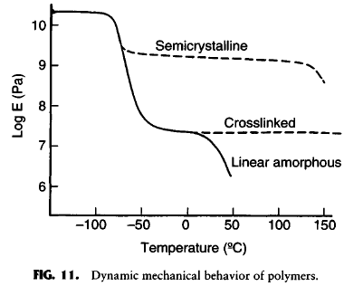
Louisiana Tech University
College of Engineering and Science
Some effects on elastic modulus
Figures from Chapter 2.2, Ratner et al., 2004
Notes:
As mentioned earlier in today’s lesson, the tensile properties of polymers are dependent on a number of factors, including temperature and degree of crystallinity. Recall that the elastic modulus (E) is the slope of the linear part of a stress-strain curve and that this is a description of how much stress a material can withstand without any permanent deformation. Stress is the force over cross sectional area with units of N/m^2, also known as pascals (Pa). (If you have not yet covered this in the prerequisite materials course, please review this in the textbook.)
This plot has the elastic modulus (E), in log scale, on the y-axis and temperature on the x-axis. (Note that body temperature is 37 degrees Celsius, or 310.15 Kelvin.) As you can see from the plot, some linear, amorphous polymers have a very low elastic modulus that rapidly decreases around and just above body temperature. Crosslinked polymers have a higher elastic modulus that does not generally decrease through a relatively large range of high temperatures. Semicrystalline polymers have an even higher elastic modulus that remains high though part of the temperature range but that can rapidly decline at temperatures used for heat sterilization. Thus, temperature and degree of crosslinking and crystallinity are important considerations when using heat sterilization of medical devices containing polymers. (Choosing (a) sterilization method(s) will be important for Project 2.)
Note, other factors also contribute to the material properties of polymers; so, this generic plot may not apply as well to a specific polymer. It is best to either look for published test data for specific polymers or to conduct tests yourself.

Slide 45
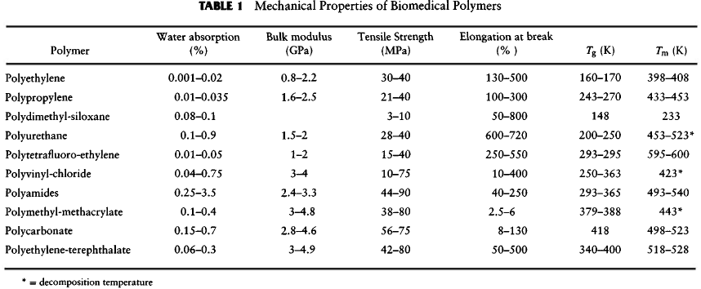
Louisiana Tech University
College of Engineering and Science
Mechanical properties
You do not need to memorize this table, but do need to know how to use it.
Figures from Chapter 2.2, Ratner et al., 2004
Notes:
This table shows the tensile strength (or sometimes referred to as the ultimate tensile strength) of several common polymers. This is the maximum force over the cross sectional area that a polymer sample can withstand before breaking. This force is applied fast enough to avoid creep. The elongation to break is dependent on how fast the part is pulled, which results in a rather large range for the “% elongation to break” property. Note that the glass transition temperature (Tg) and the melting temperature (Tm) are listed in the table. You do not need to memorize the table, but you will need to know how to use this type of table for projects and maybe a quiz or an exam or two.

Slide 46
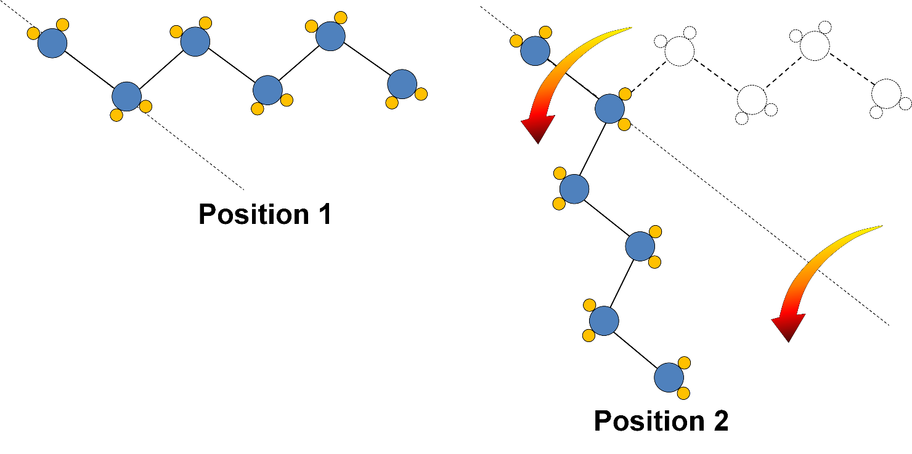
Rotational Freedom of Polymer Chains
Louisiana Tech University
College of Engineering and Science
Flexibility is result of rotation of C-C sigma bonds, NOT the redirection of C-C bonds (that would lead to brittle fracture)
Chain flexibility is directly controlled by its rotational freedom
Chen and Thouas, Chapter 8 Biopolymers
Notes:
Polymer chains generally bend very easily. Why? This is mainly due to the freedom of carbon-carbon sigma bonds in the polymer backbone to rotate, as you can see in the illustration on this slide.

Slide 47
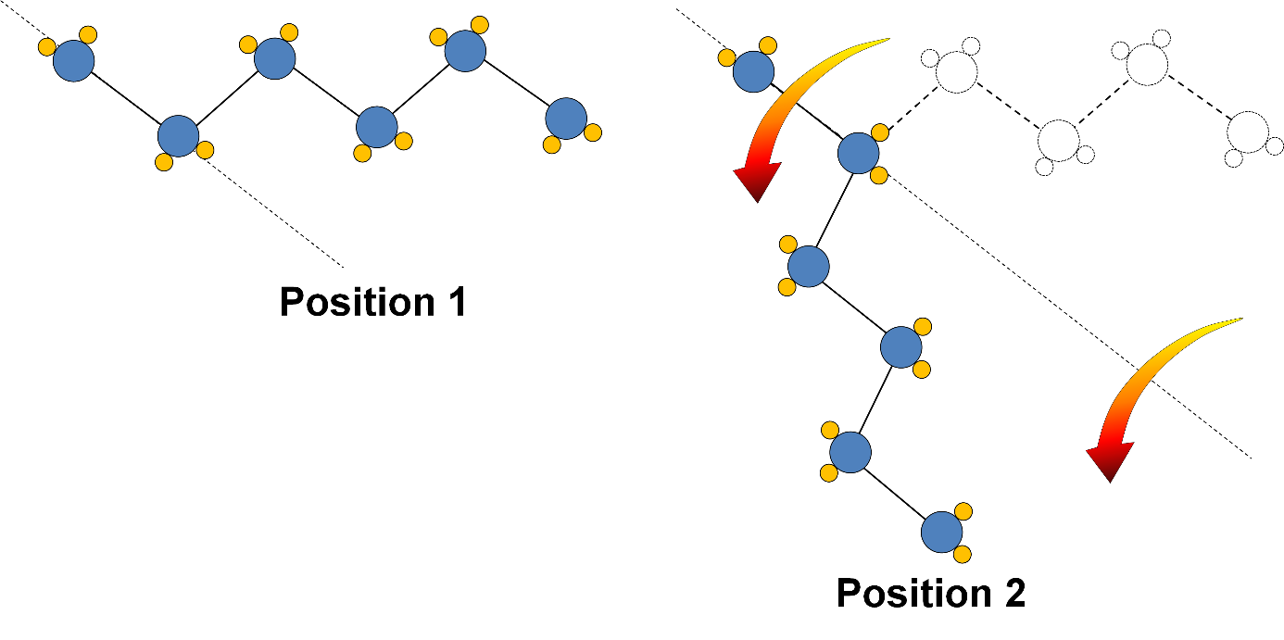
Loss of Rotational Freedom
Louisiana Tech University
College of Engineering and Science
The flexibility of chains can be reduced by
Chain length
Physical barriers (other particles)
Chemical crosslinks & physical entanglements with other chains
Chen and Thouas, Chapter 4
Notes:
See list on slide.

Slide 48
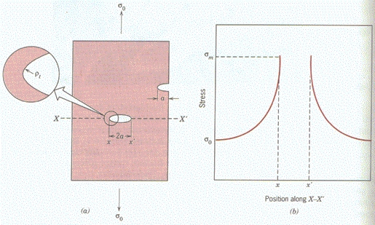
Stress concentrators
Louisiana Tech University
College of Engineering and Science
Material becomes weaker than its fracture (ultimate, tensile) strength
Callister and Rethwisch, Materials Science and Engineering, 8th Ed. 2010, John Wiley & Sons
Notes:
Every material has at least a few imperfections that can cause stress concentrators. The concentration of stress in a material can cause the stress level to exceed the ultimate tensile strength of the material. This causes cracks to form as device parts are exposed to on-off stresses in the body. The cracks add to the number of stress concentrators in the part. Eventually the part breaks. Thus, it is not possible to tell how long a component will last in actual use based solely on the ultimate tensile strength of the material. The material must also be subjected to cyclic stress (loading and unloading)

Slide 49
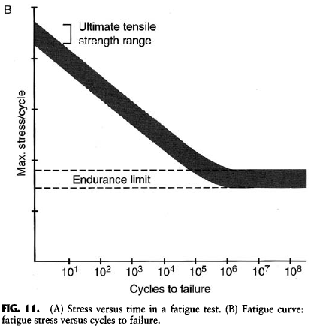
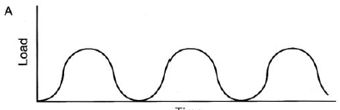
Louisiana Tech University
College of Engineering and Science
Endurance limit
X
X
X
X
X
X
X
X
X
Time
X
X
X
X
X
X
X
X
Cyclic loading to simulate years of repetitive stress
Figures from text: Ratner et al., 2004
Notes:
The plot to the left represents cyclic loading (tension) and unloading (compression) of a sample of material (or of the actual part made of that material). The level of maximum stress applied to the material ranges from the ultimate tensile strength range at the high end to a very low amount of stress. Each red x on the plot to the right shows the level of stress (on the y-axis) and the number of cycles the sample was exposed to before it broke. As the plot shows, the material lasts for only a few cycles before failure occurs when it is placed under high stress. Samples exposed to less stress last longer. Eventually, the stress level reaches a point where the parts no longer fail and the number of cycles before breakage occurs can be in the tens of thousands and even tens of millions of cycles (this simulates years of use). This level of maximum stress is known as the endurance limit. Knowing the endurance limits for materials is an important consideration in selecting the optimal material(s) for a medical device that will be exposed to cyclic stress. Can you think of a few devices that must endure cyclic stress?

Slide 50
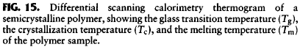
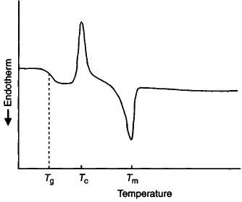
Louisiana Tech University
College of Engineering and Science
-
Figures from Chapter 2.2, Ratner et al., 2004
Notes:
Differential scanning calorimetry is an analytical test used to determine the temperatures for the glass transition (Tg), crystallization (Tc) and melting (Tm) of a polymer. Endothermic and exothermic changes occur at these transitions. The sensors detect these changes as the sample is exposed to increasingly higher levels of heat. The slide shows a thermogram from such a test. The transition temperatures are marked on the temperature axis.

Slide 51

Louisiana Tech University
College of Engineering and Science
Environment affects surface chemistry
Figures from text: Ratner et al., 2004
Notes:
Polymers have bonds that often allow the molecule to spin around the polymer backbone (this concept was introduced on a previous slide in this lesson). Poly(HEMA) has two side groups that can spin around the backbone. One side group is hydrophilic (group shown at bottom of chemical diagram) and the other is hydrophobic (the CH3 group at the top). When the material is stored in air, the hydrophobic group spins to the surface of the material. When the material is placed in an aqueous environment, the hydrophilic group spins around so that it is on the surface. This is a material for contact lenses. It is also an amorphous polymer which means that it is translucent; this is also a useful property for contact lenses.

Slide 52
Louisiana Tech University
College of Engineering and Science
Modified natural fibers as biomaterials
Can be well suited for medical applications
Cellulose (processed cotton or wood pulp)
Very common in medical field in disposable products
Low cost
Highly absorbent
Example: disposable diapers
Almost never used for in vivo applications
Highly inflammatory reactions
Example: Surgicel (a hemostat)
Alternatives for in vivo uses may be modified polysaccharides
Alginates, xanthan gum, chitosan, dextran, and reticulated cellulose
Figure from Chapter 2.4, Ratner et al., 2004
Notes:
See information in slide.

Slide 53

Louisiana Tech University
College of Engineering and Science
Textiles used in medical devices
You do not need to memorize this table.
Table from Chapter 2.4, Ratner et al., 2004
Notes:
This table shows the wide range of uses for textiles in biomedical devices. There is no need to memorize this information. If needed, the table will be provide.

